Slide 1

DHAKA INTERNATIONAL UNIVERSITY
WELCOME
TO
OUR PRESENTATION
Wednesday, 12-February-2020, 4.00 PM
Batch : 54th (2nd Shift) Final-Defense
Page-01

Slide 2
DHAKA INTERNATIONAL UNIVERSITY
PROJECT TITLE :
Real-time Vehicle License Plate Detection and Traffic Control System
Batch : 54th (2nd Shift) Final-Defense
Page-02

Slide 3
SUPERVISOR and MEMBERS IDENTITY
Presented by
SL. No. | Name | Roll | Reg. No.
1 | Md.Nawfel Islam | 04 | 102148
2 | Md. Kausar Ali | 09 | 102153
3 | Md. Hossian | 24 | 102223
4 | Md:Ariful Islam | 39 | 102238
 | Md: Abu Sayed | 45 | 102273
Batch: 54th, Session (2016-2017)
Supervised by
Al Bashir
Lecturer
Department of CSE.
Dhaka International University
Batch : 54th (2nd Shift) Final-Defense
Page-03

Slide 4
KEY CONTENTS OF PRESENTATION ABOUT PROJECT
Introduction
Objectives
Features of Project
Methodology
Flow chart
Number Plate Detection Model
Project Overview
Future Scope
Limitation of Project
Conclusion
Batch : 54th (2nd Shift) Final-Defense
Page-04

Slide 5
INTRODUCTION
REAL-TIME VEHICLE LICENSE PLATE DETECTION &TRAFFICE CONTROL SYSTEM
Automatic number-plate recognition is a technology that used template matching on images to read vehicle registration plates to create a data base information of car owner. It can use existing closed circuit TV, road rule enforcement cameras or cameras specifically designed for the task. ANPR is used by police forces around the world for law enforcement purposes, including to check if a vehicle is registered or licensed. It is also used for electronic toll collection on pay per use roads and as a method of cataloguing the movements of traffic, for example by highways agencies
Batch : 54th (2nd Shift) Final-Defense
Page-05

Slide 6
OBJECTIVES
To automatic number-plate recognition by technology
To electronic toll collection
To detect the guilty vehicles who are involved in the crime
To digital traffic control system
And road safety procedure for people
Batch : 54th (2nd Shift) Final-Defense
Page-06

Slide 7
FEATURES OF REAL-TIME VEHICLE LICENSE PLATE DETECTION &TRAFFICE CONTROL SYSTEM PROJECT
Digital Traffic Control
Vehicle Owner Identification
Maintain Traffic Rules
Electronic Toll System
Data Store of Vehicle
Checking Vehicle License
Road safety for people
Batch : 54th (2nd Shift) Final-Defense
Page-07

Slide 8
METHODOLOGY OF PROJECT
In this Section, there will be the description of the methods and techniques. The system is designed for recognizing of Bangla and English vehicle license number plate. In general term, the model consists of mainly four computational steps.
Take image from live traffic camera
Converting the RGB (color) image to gray (intensity)
Median filtering to remove noise
Structural element (disk of radius 1) for morphological processing
Morphological image processing
Remove non important object
Fill the image
Selecting all the regions that are of pixel area more than 100
Segmentation
Character recognition
Display result
Design and Development
Tools & Language
Batch : 54th (2nd Shift) Final-Defense
Page-8

Slide 9
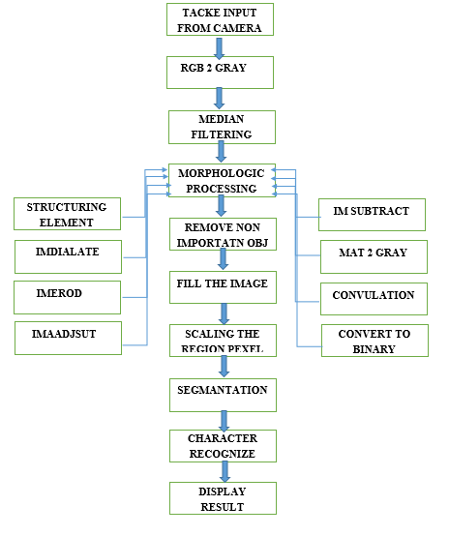
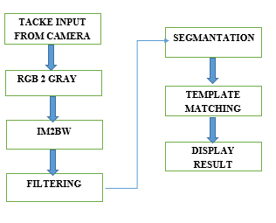
Flow Chart OF Project propos model
For English
For Bangla
Figure : Flow Chart of Real-Time Vehicle License Plate Detection
Batch : 54th (2nd Shift) Final-Defense
Page-9

Slide 10
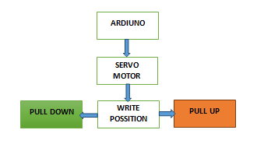
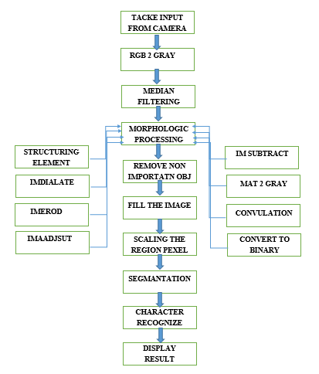
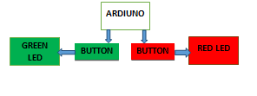
Number plate recognized and template match and Traffic Control System Flowchat
Figure : Proposed Model
Figure : Ardiuno ,Servo, LED
Batch : 54th (2nd Shift) Final-Defense
Page-10

Slide 11
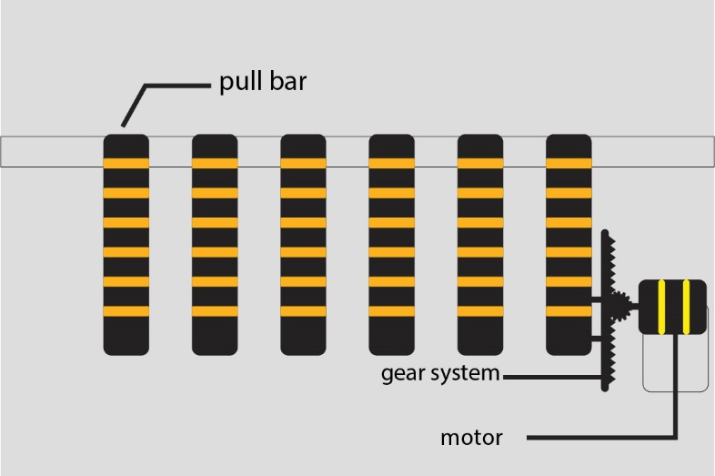
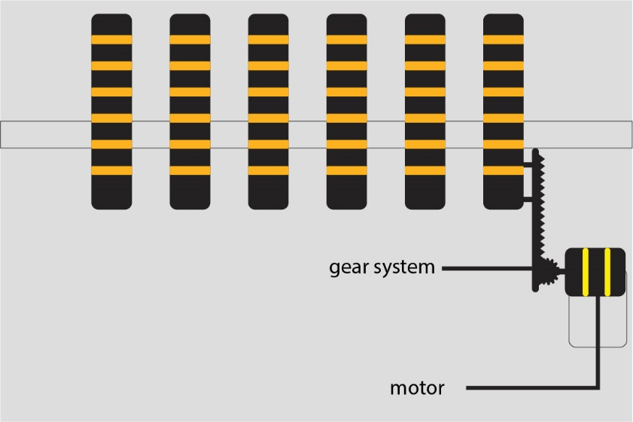
Road safety system in traffic area
Figure : Pull down model
Figure : Pull up Model
Batch : 54th (2nd Shift) Final-Defense
Page-10

Slide 12
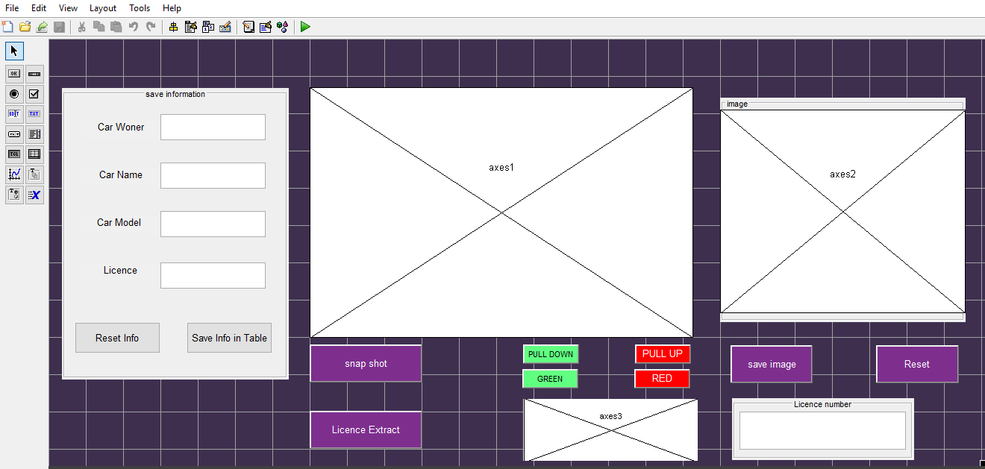
PROJECT OVERVIEW
Figure : GUI Design
Batch : 54th (2nd Shift) Final-Defense
Page-11

Slide 13
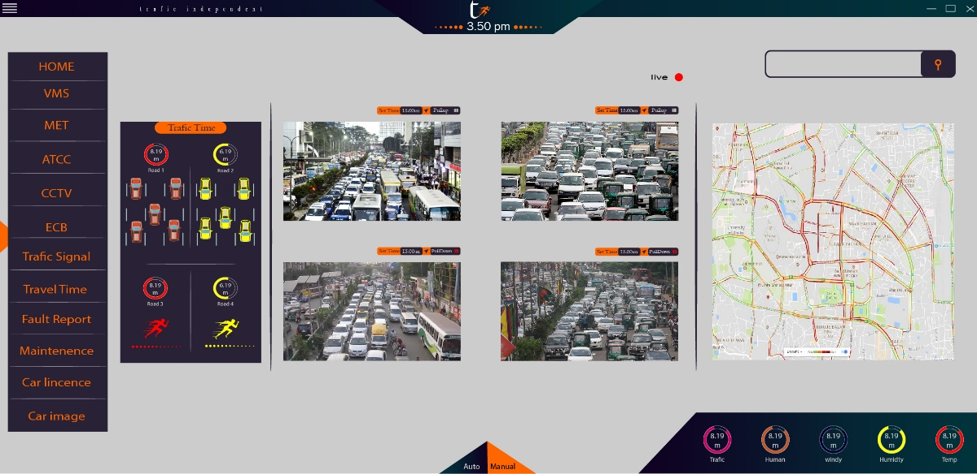
PROJECT OVERVIEW (CONTINUE……..)
Figure : Future Work GUI
Batch : 54th (2nd Shift) Final-Defense
Page-12

Slide 14
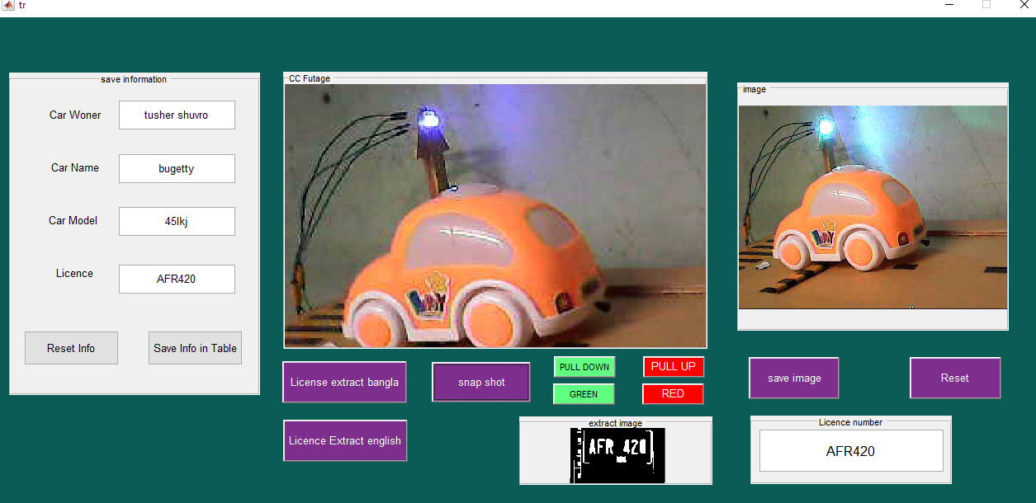
PROJECT OVERVIEW (CONTINUE ……)
Figure : current application interface
Batch : 54th (2nd Shift) Final-Defense
Page-13

Slide 15
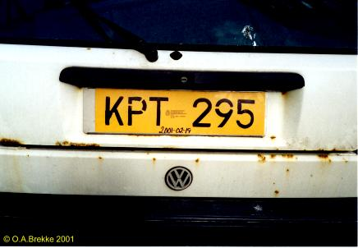
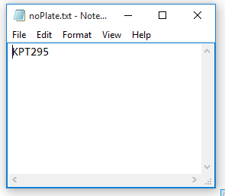
PROJECT OVERVIEW (CONTINUE ……)
Figure : output result in txt file
Figure : Input image
Batch : 54th (2nd Shift) Final-Defense
Page-14

Slide 16
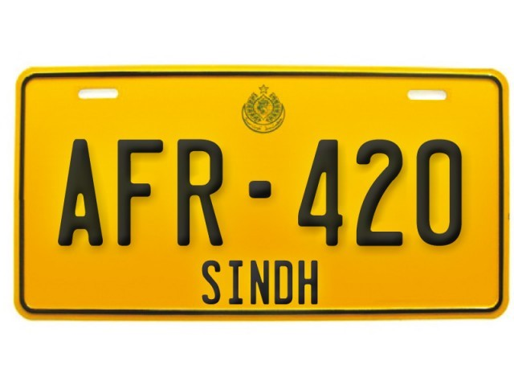
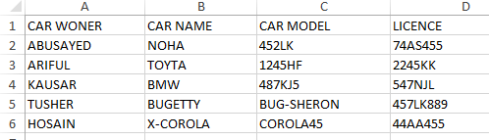
PROJECT OVERVIEW (CONTINUE ……)
Figure : Input image
Figure : Result
Batch : 54th (2nd Shift) Final-Defense
Page-15

Slide 17
PROJECT LIMITATION
Require high-quality camera
server maintenance cost
Digging the road site for pull bar system
High configuration computer
Batch : 54th (2nd Shift) Final-Defense
Page-16

Slide 18
FUTURE SCOPE
It can detect Bangla and English car license
It can detect the driver license
Maintenance the traffic control system artificially without no human operating
It provide a safe traffic road cross for people by using pull up down system
The future system can monitoring all traffic in the city from one control room
Batch : 54th (2nd Shift) Final-Defense
Page-17

Slide 19
CONCLUSION
ANPR can be further exploited for vehicle own identification, vehicle model identification traffic control, vehicle speed control and vehicle location tracking. It can be
In this Book, worked with still image captured from road side vehicles and proposed a method to detect and recognize car number plate Bangla and English . The proposed method have greater accuracy to localize the number plate as it can detect the number plate from both side front and rear. This method can detect different background color number plates (green and white) captured in morning and evening sunlight. The method achieve a good processing time as well, take 0.18sec for overall process. Performance of the method increased with the quality of the image as well.
Batch : 54th (2nd Shift) Final-Defense
Page-18

Slide 20
This Idea Will Helpful For Us?
What do You Think ?
Batch : 54th (2nd Shift) Final-Defense
Page-19

